Slide 1

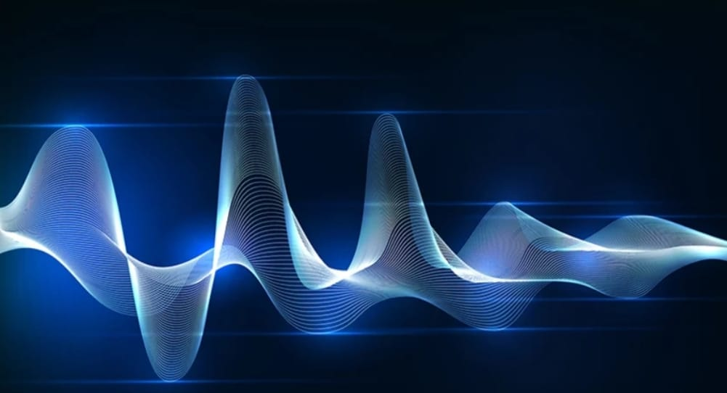
SPEECH TO TEXT CONVERSION
201FA04140-B.Deepthi
201FA04147-G.Durga Susmitha
201FA04172-V.Lavanya

Slide 2
Outline
Introduction
Problem formulation
Objectives of work
Methodology
Performance
Conclusion
Future Scope
References

Slide 3
Introduction
Speech to text conversation is the process of converting spoken words into written texts.
Nearly 20% people of the world are suffering from various disabilities; many of them are blind or unable to use their hands effectively. They can share information with people by operating computer through voice input.
Speech recognition technology is one of the fast growing engineering technologies.

Slide 4
Motivation
Speech recognition is an interdisciplinary subfield of computer science and computational linguistics that develops methodologies and technologies that enable the recognition and translation of spoken language into text
Our project is capable to recognize the speech and convert the input audio into text; it also enables a user to perform operations such as open calculator, wordpad, notepad, log off computer.

Slide 5
Problem Formulation
Unable to understand audio files.
Eg: In any academic event, information is usually addressed through audio channel so that students with learning or physical disabilities, foreign students, and other at risk populations are challenged to understand the content.
In relation to online learning literature, problem is the poor audio quality.
Eg: Due to restricted internet bandwidth availability and traffic congestion, students are not able to understand concepts clearly

Slide 6
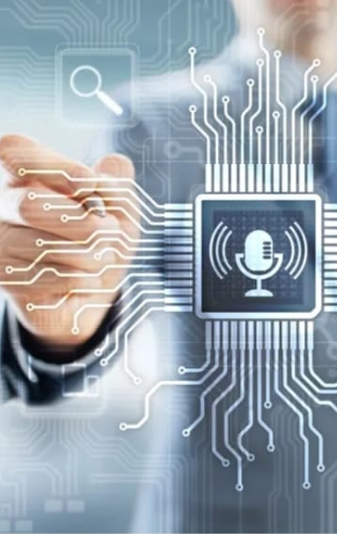
Cont........
Unable to type every word while listening
Eg: While in a online class, it is not possible to write every word.
So, we are solving this problem by our project "Speech into Text" that is a complete student/teacher oriented platform to help in taking notes and understanding.

Slide 7
Applications
In Car Systems
Health Care
Military
Training air traffic controllers
Telephony and other domains
Usage in education and daily life

Slide 8

Objectives of the work
The main goal of this Python based project is to build a recommendation engine that converts speect to text.
A conversion algorithm will also look for mic and recorded files.
A conversion system is a platform that serves up large audio files, and different languages

Slide 9
Hardware Requirements
Name of component | Specification
Processor | i5 processor
RAM | 4Gb & More
Hard-Disk | 2gb & More

Slide 10
Software Requirements
Chrome
Google
Idle 3.10
Cloud
Speech recognition
Tkinter
Pyaudio

Slide 11
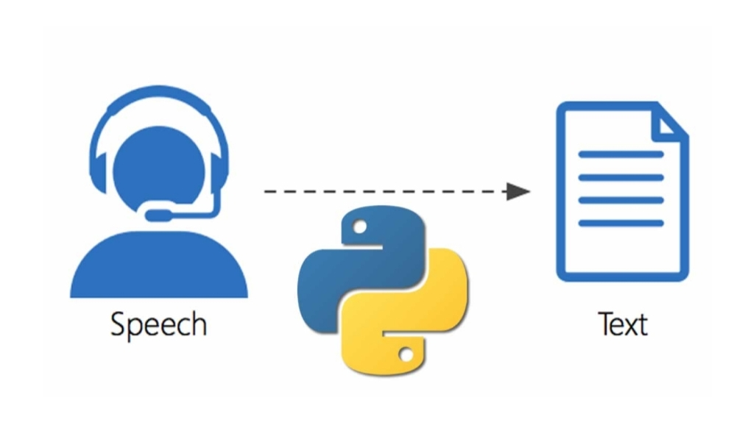
Appropriate Solution
The following methodology will be followed to achieve the objectives defined for proposed research work:
Installing Python Libraries: Install library like tkinter, speech recognition, pyaudio.
Importing Speech Recognition: Importing google speech module.
Converting wav files into Text: Selecting and extracting text

Slide 12

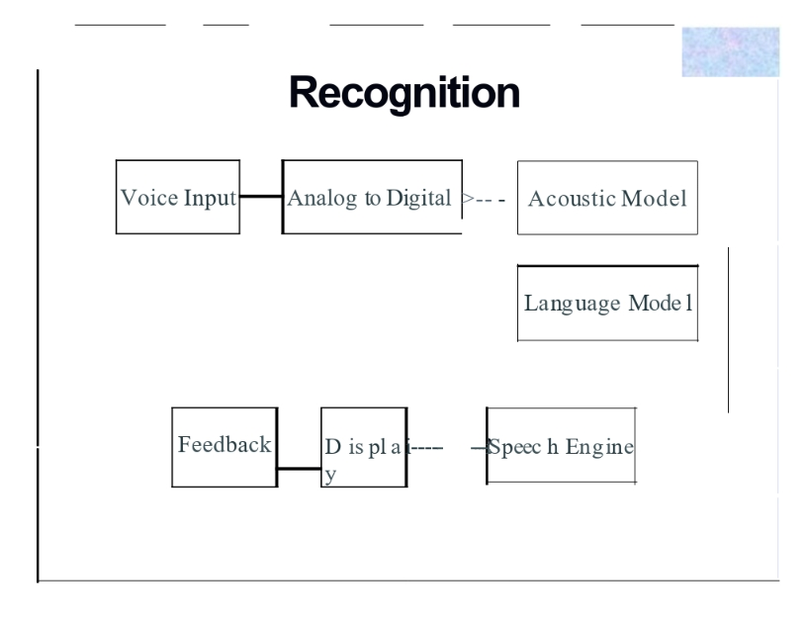

System Block Diagram
Acoustic Model: An acoustjc model is created by taking audio recordings of speech, and their text transcriptions, and using software to create statistical representations of the sounds that make up each word. It is used by a speech recognition engine to recognize speech.

Slide 13
Cont.........
Language Model: A language model is a file containing the probabilities of sequences of words. Language models are used for dictation applications, whereas grammars are used in desktop command and control or telephony interactive voice response (IVR) type applications.
Speech Engine: A speech engine is software that gives your computer the ability to play back text in a spoken voice (referred to as text-to-speech or TI S).

Slide 14
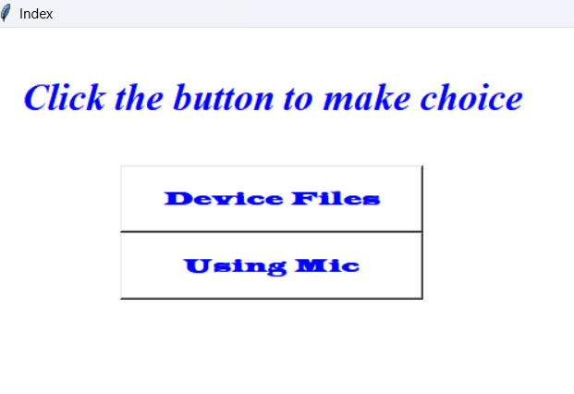
Results and output

Slide 15
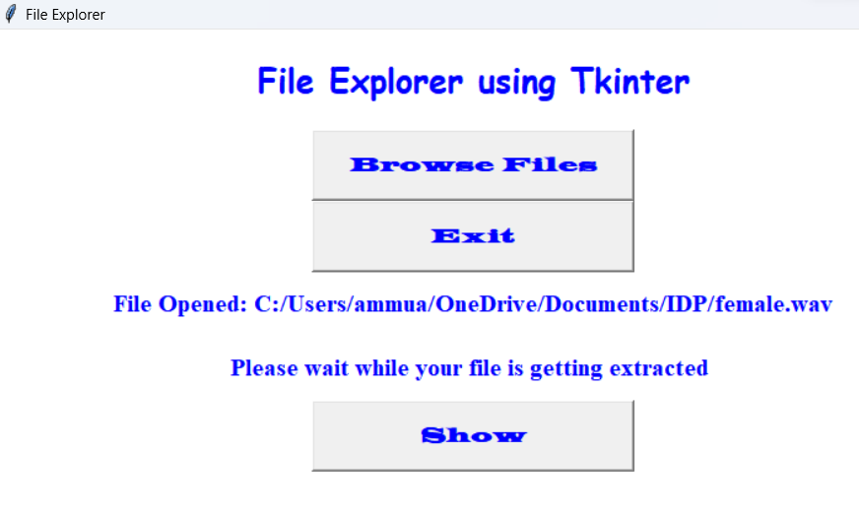

Slide 16
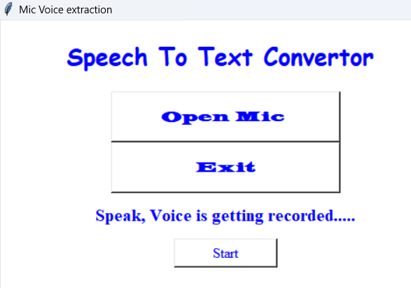

Slide 17
Performance
The performance of speech recognation system is usually evaluated in terms of accurecy and speed.
Accuracy is usually rated with Word Error Rate (WER), whereas speed is measured with the real time factor. Other measures of accuracy include Single Word Error Rate (SWER) and Command Success Rate (CSR).

Slide 18
Advantages
Able to write the text both through keyboard and voice input.
Voice recognition of different notepad commands such as open save and clear.
Open different windows softwares, based on voice input.
Lower operational costs.
Provide significant help for the people with disabilities.
Requires less consumption of time in writing text.

Slide 19
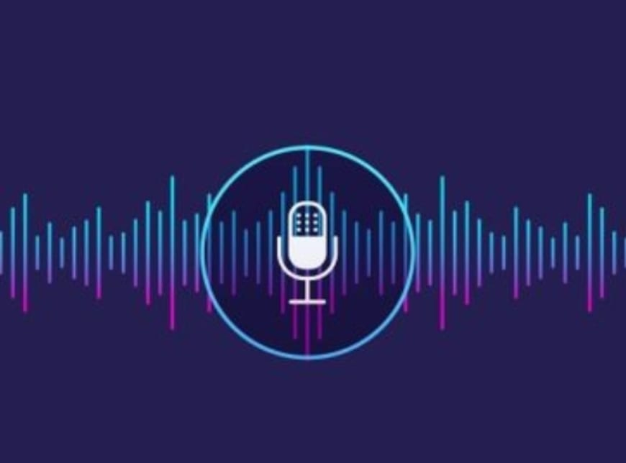
Weakness
Homonyms: Are the words that are differently spelled and have the different meaning but acquires the same meaning, for example "there" "their", "be" and "bee". This is a challenge for computer machine to distinguish between such type of phrases that sound alike.
Speeches: A second challenge in the process, is to understand the speech uttered by different users, current systems have a difficulty to separate simultaneous from multiple users.

Slide 20
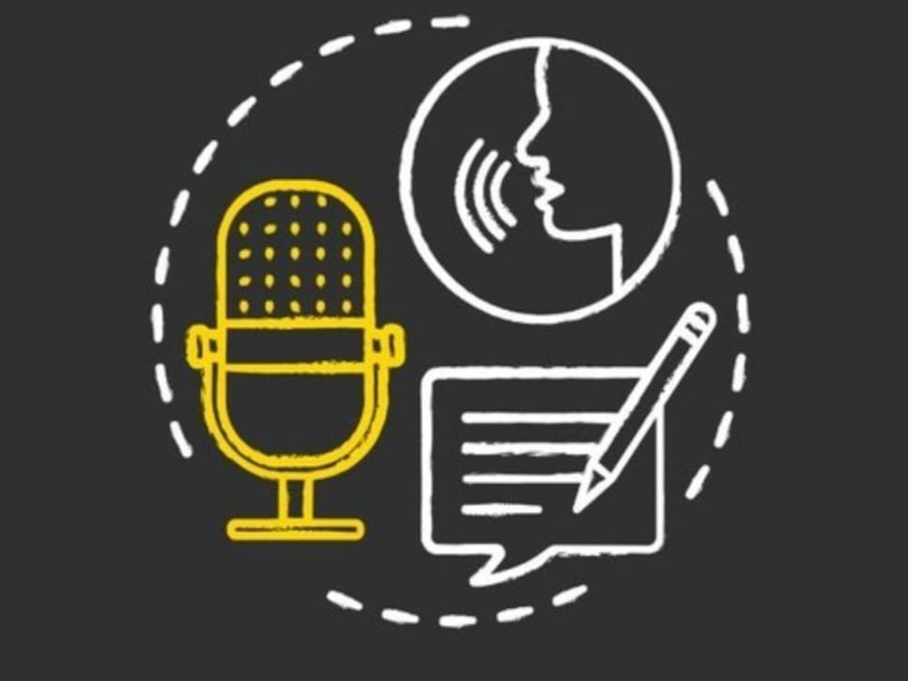
Cont........
Noise factor: The program requires hearing the words uttered by a human distinctly and clearly. Any extra sound can create inted'erence, first you need to place system away from noisy environments and then speak clearly else the machine will confuse and will mix up the words.

Slide 21
Conclusion
Although speech-to-text conversion machines aim at providing benefits for the deaf or people who can't speak, it is difficult to review, retrieve and reuse speech transcripts.
So, when the speech to text conversion module is combined with the summarization, the application further increase in educational fields as well.
This chapter discussed the need for speech summarization, various issues in the summarization of a spoken document, supervised, and unsupervised summarization algorithms

Slide 22
Future Work
Accuracy will become better and better
Dictation speech recognition will gradually become accepted
Greater use will be made of "intelligent systems" which will attempt to guess what the speaker intended to say, rather than what was actually said, as people often misspeak and make unintentional mistakes.
Microphone and sound systems will be designed to adapt more quickly to changing background noise levels, different environments, with better recognition of extraneous material to be discarded

Slide 23
References
https://www.britannica.com/technology/speech-recognition
https://support.microsoft.com/en-us/windows/dictate-text-using-speech-recognition-854ef1de-7041-9482-d755-8fdf2126ef27
https://cloud.google.com/speech-to-text
https://www.geeksforgeeks.org/python-convert-speech-to-text-and-text-to-speech/

Slide 24
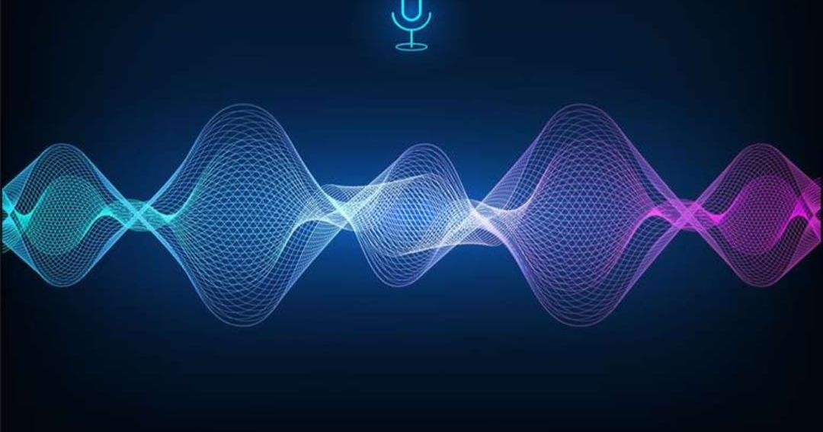
Thank you

